Slide 1
System and Cyber Security
L. Budi Handoko, M.Kom. (handoko@dosen.dinus.ac.id /
handoko@dsn.dinus.ac.id)
Dian Nuswantoro University

Slide 2
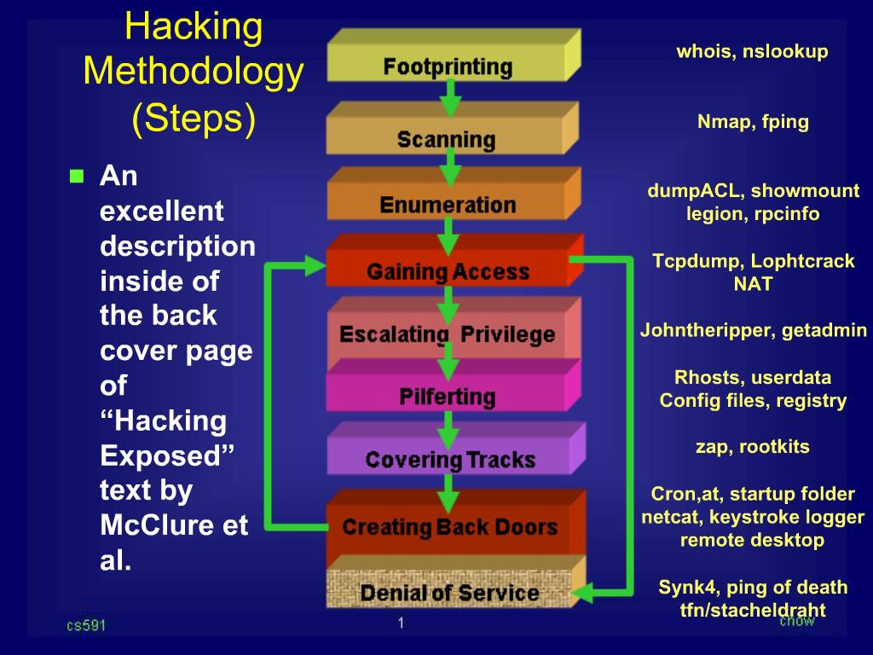

Slide 4
Footprinting
Gathering information regarding a specific network environment of a taget.
Finding ways to intrude into the network environment.
Can be used to attack a system, and also to protect it.
In this phase, the attacker creates a profile of the target organization, with the information such as its IP address range, namespace, and employee web usage.
Improves the ease with which the systems can be exploited by revealing system vulnerabilities.
Determining the objective and location of an intrusion is the primary step involved.
Once the objective and location of an intrusion is known, specific information about the organization can be gathered.

Slide 5
Scanning
Process for identifying active or target hosts on a network, either for the purpose of network security assessment or for attacking them.
Try to finds information about the target assessment through its IP addresses that can be accessed over the Internet.
Scanning is mainly concerned with the identification of systems on a network and the identification of services running on each target.
Some of the scanning procedures such as port scans and ping sweeps return information about the services offered by the live hosts that are active on the Internet and their IP addresses.

Slide 6
Enumeration
Enumeration is the method of intrusive probing into the target assessment through which attackers gather information such as network user lists, routing tables, and Simple Network Management Protocol (SNMP) data.
The objective is to identify valid user accounts or groups where he or she can remain inconspicuous once the system has been compromised.
Enumeration involves making active connections to the target system or subjecting it to direct queries.

Slide 7
Gaining Access
Collecting enough information to gain access on targeted system.
Technique that can be used include password eavesdropping, brute force, buffer overflow, etc.

Slide 8
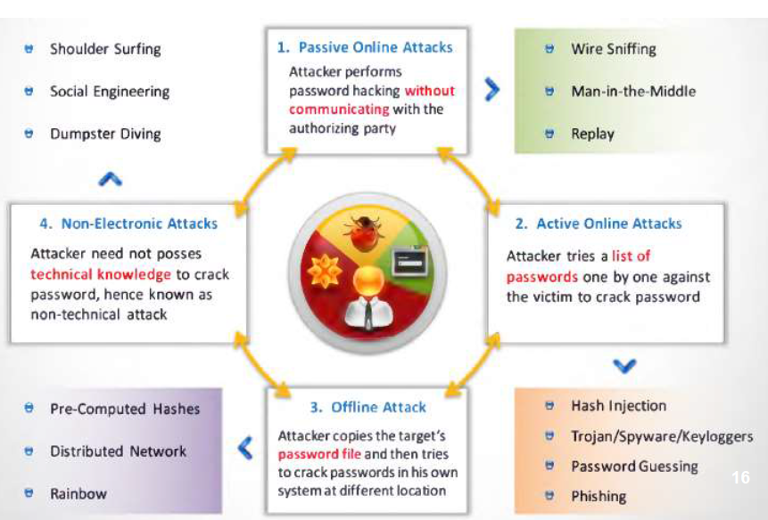
Types of Password Attacks

Slide 9
Escalating Privileges
Create a privileged user account if the user level is obtained.
Technique that can be used is password cracking, exploiting, etc.

Slide 10
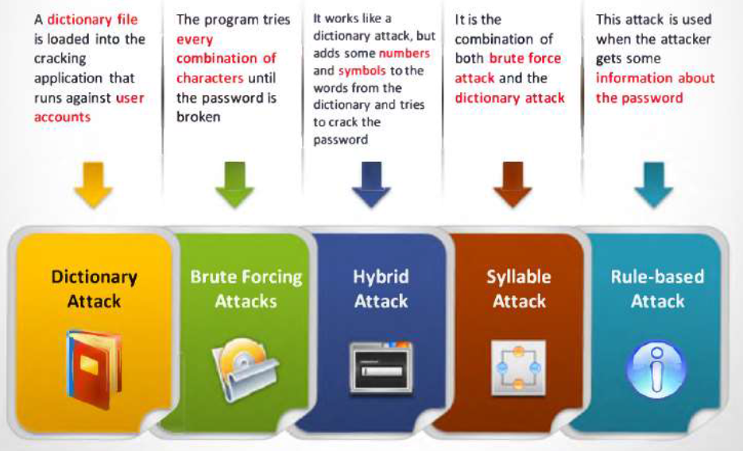
Password Cracking Techniques

Slide 11
Pilfering
Gathering info on identify mechanisms to allow access of trusted systems and launch a payload.
Technique that can be use is evaluate trust or search for cleartext password inside the existing and production systems.

Slide 12
Covering Tracks
Hide the presence on compromise systems.
Can be done by clearing all logs that exists inside the systems.
Rootkits can be used for hiding files or else.

Slide 13
Creating Backdoor(s)
Trap door will be laid in various parts of the system to ensure the privilege access is easily regained whenever the intruder wants.
Technique can use a schedule batch jobs, infect startup files or services, create a rogue user account with escalated privileges, plant RAT, etc.

Slide 14
Attack Goals (Denial of Services)
Owned the system, and …
It is time to launch a full payloads.
If no access gained, use readily available exploit to disable the target as the last resort, or …
Use the systems to target another systems as a cover.

Slide 15
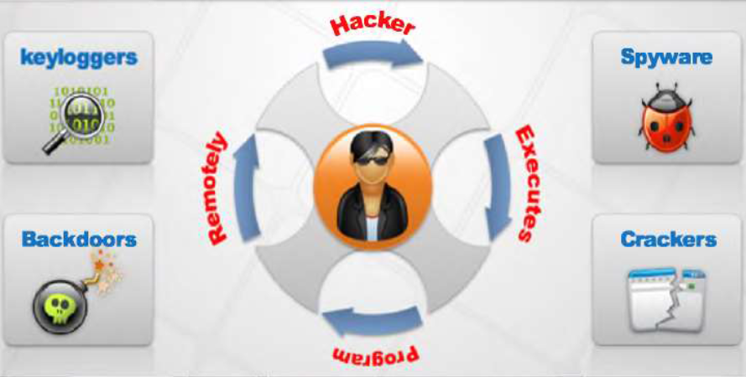

Slide 16


Slide 17

Any Question ?
Anything to discuss ?

Slide 18


